Slide 1
Small system (4 absorbers and 2 emitters)
The model works better when two emitters also exchange energy. The residue becomes much high when there is no communication between emitters. (Different combinations of angles have been tested)

Slide 2
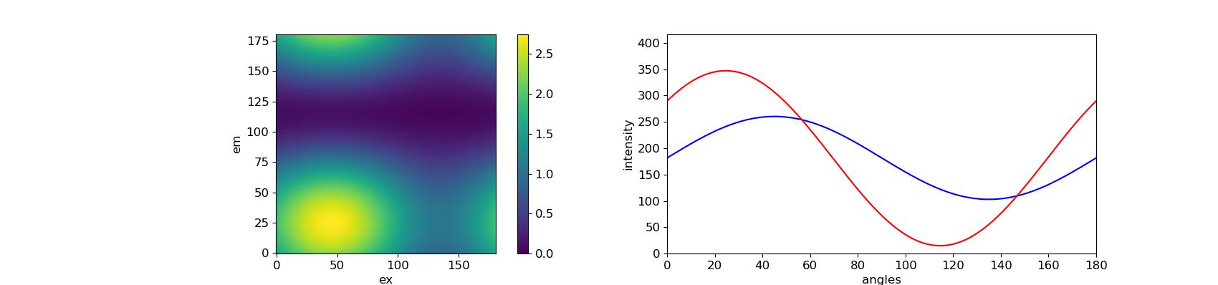
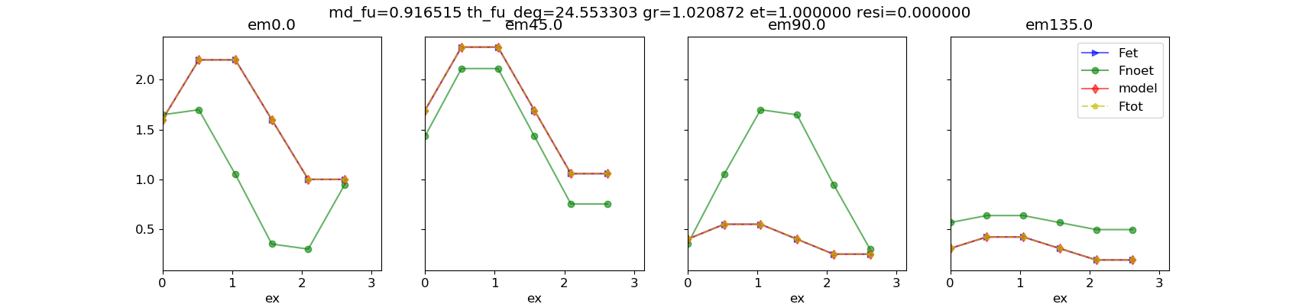
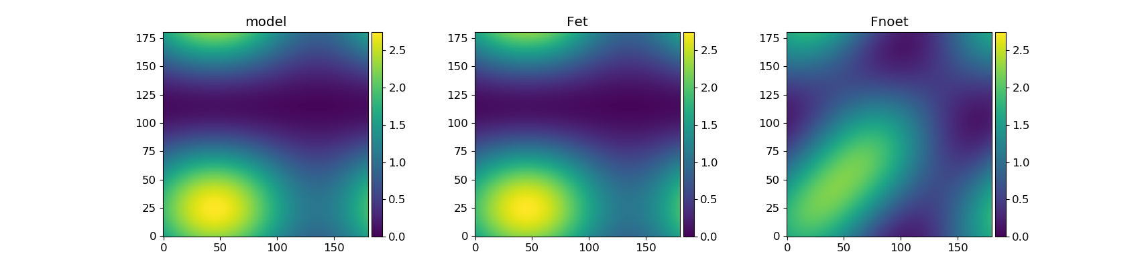
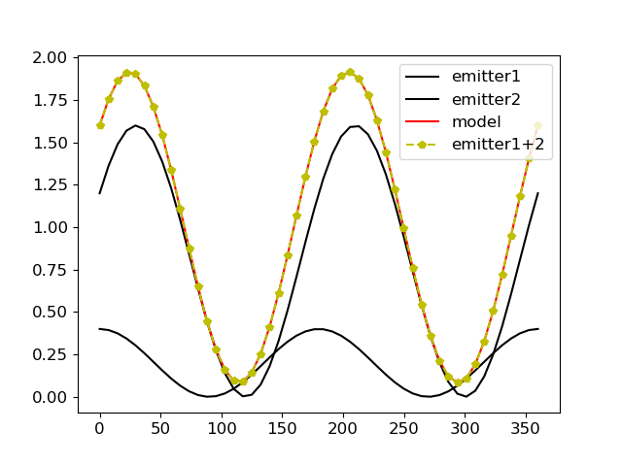
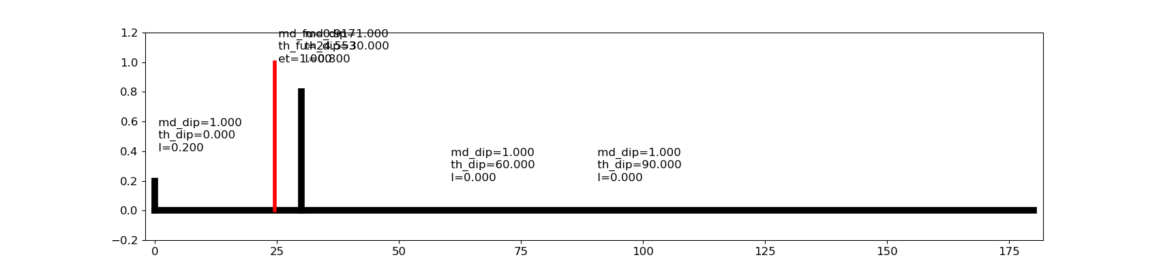
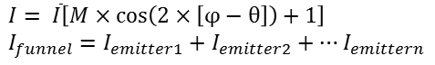
[0, 30, 60, 90]
[0.2, 0.8, 0.0, 0.0]
[0.2, 0.8, 0.0, 0.0]
[0.2, 0.8, 0.0, 0.0]
[0.2, 0.8, 0.0, 0.0]
The SFA3 fitting is good when the two emitters also exchange energy.
The funnel is linear superposition of emitters. If the angle between emitters becomes larger, for example, two emitters at 0° and 100°, then the M_funnel will be decreased to 0.62.
$$I= \overline{I}\left[M×\cos\left(2×\left[φ−θ\right]\right)+1\right]$$
$$I_{funnel}=I_{emitter1}+I_{emitter2}+…I_{emittern}$$

Slide 3
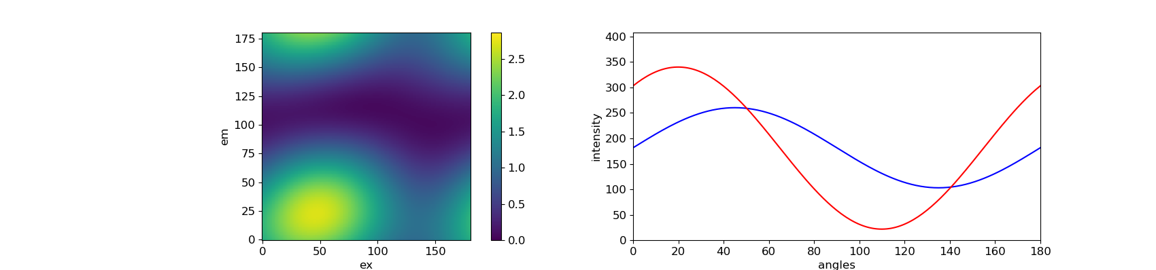
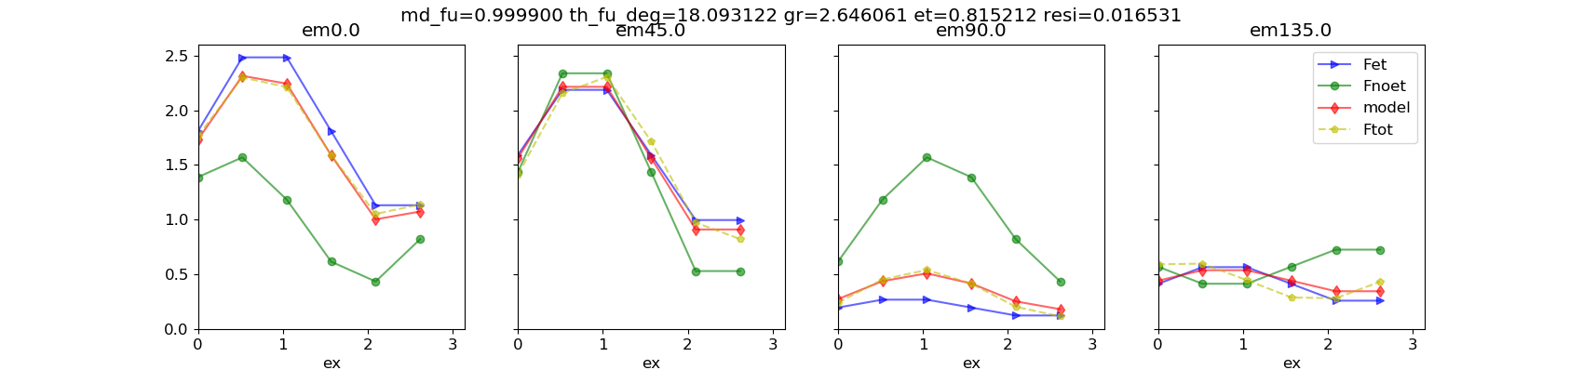
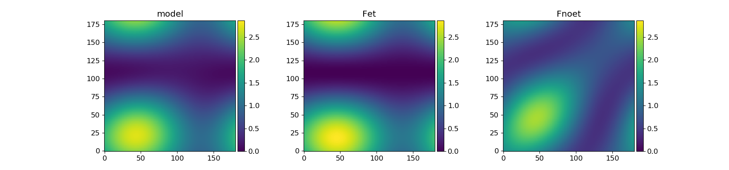
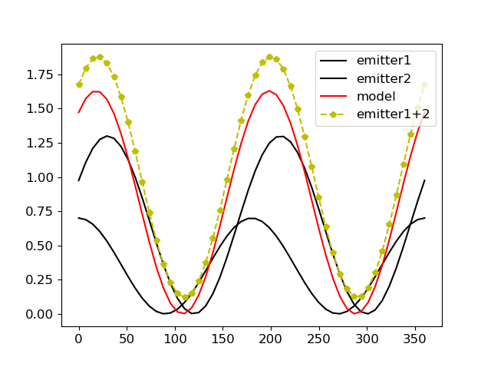
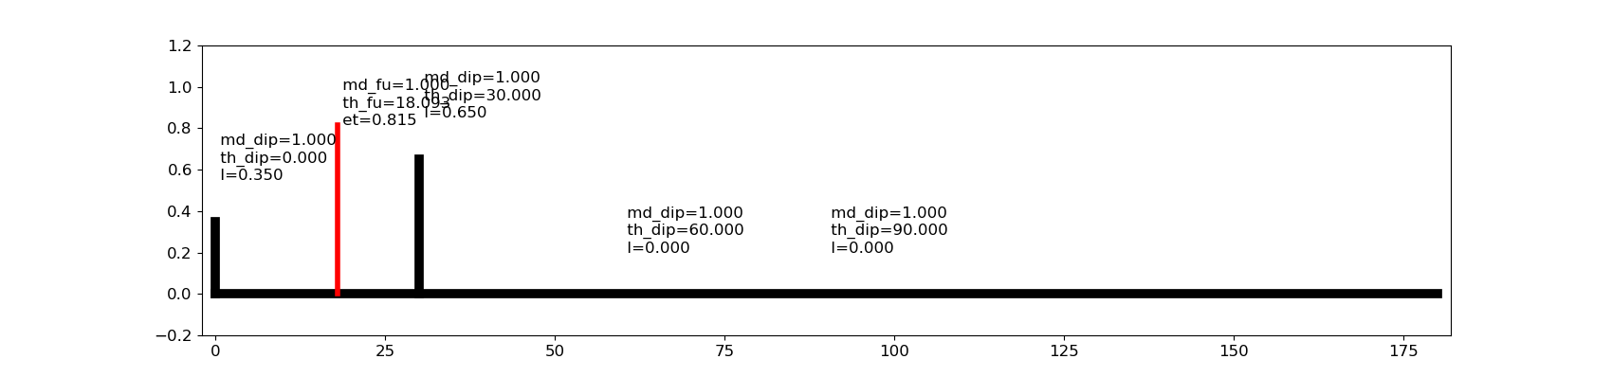
[0, 30, 60, 90]
[1.0, 0.0, 0.0, 0.0]
[0.0, 1.0, 0.0, 0.0]
[0.2, 0.8, 0.0, 0.0]
[0.2, 0.8, 0.0, 0.0]
The residue becomes higher when there is no exchange energy between two emitters.
The funnel (red curve) is not perfectly linear superposition of emitters (yellow dashed curve). Even the angle between emitters becomes larger, for example, two emitters at 0° and 100°, the M_funnel is still equal to 1.

Slide 4
What if there are more dipoles (1000) ?
emitter1
emitter2
For the system possessing large amout of dipoles (1000 absorbers and 2 emitters), the above effect is not obvious. They have almost the same property of funnel (M, phase, et) and fitting residues are very low.

Slide 5
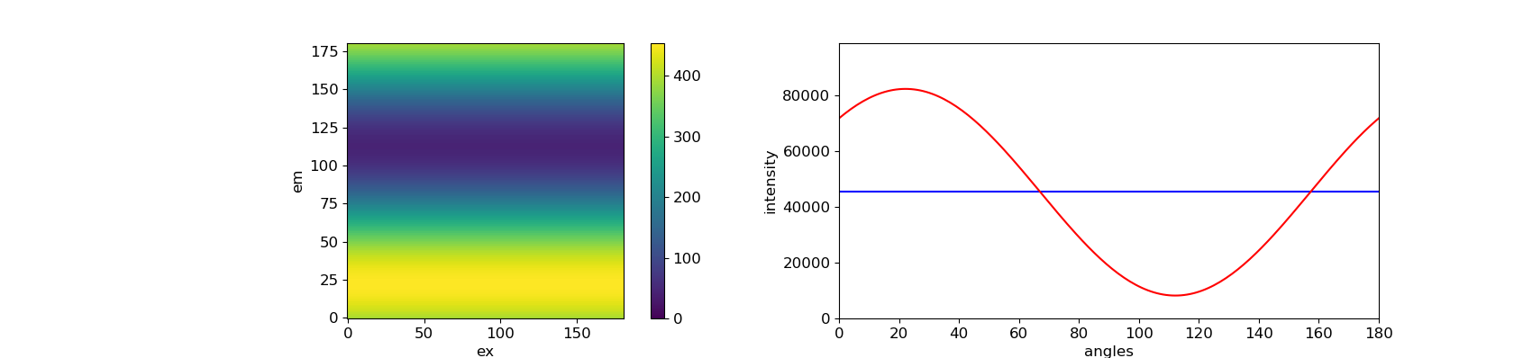
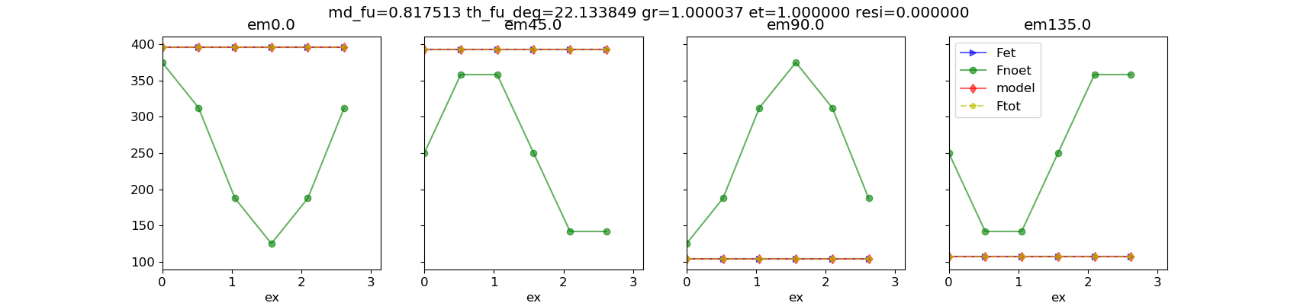
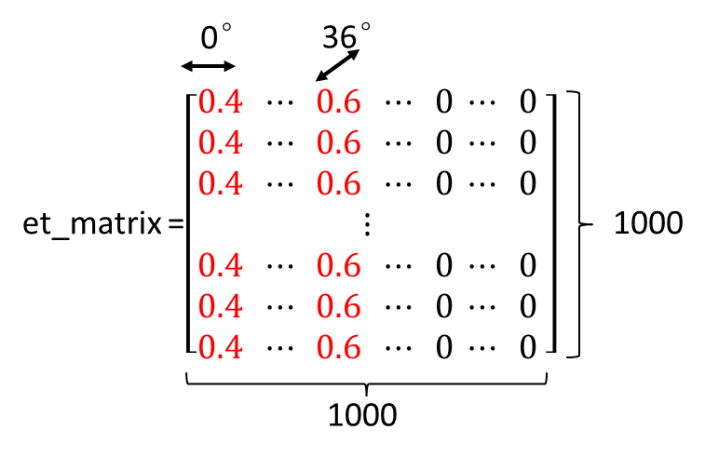
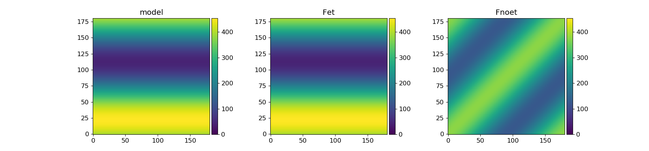
There is ET between two emitters
0.4
emitter1
0.4
0.6
0.6
emitter2

Slide 6

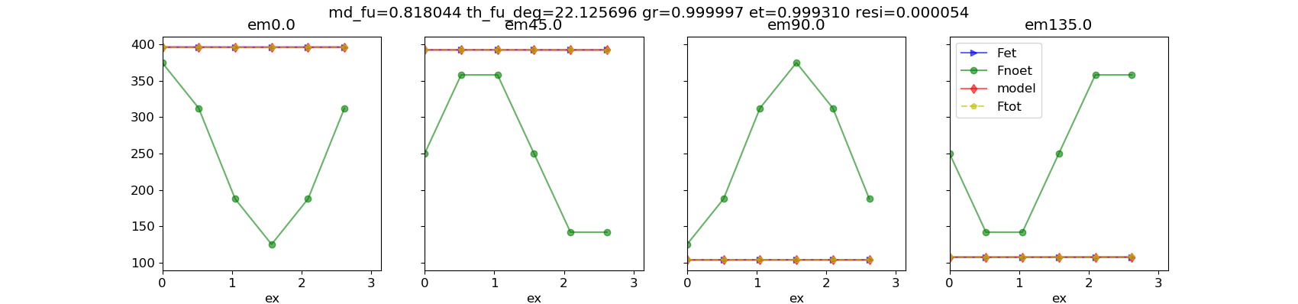
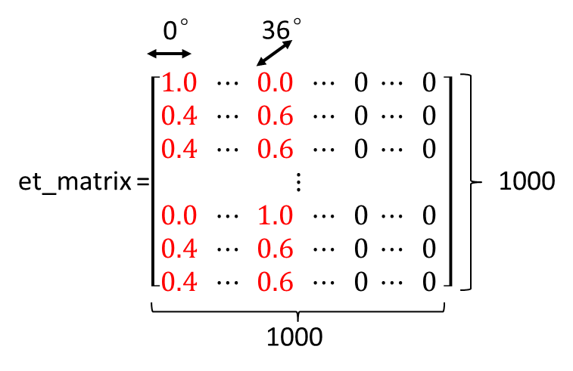

There is no ET between two emitters
0.4
emitter1
0.6
emitter2

Slide 7
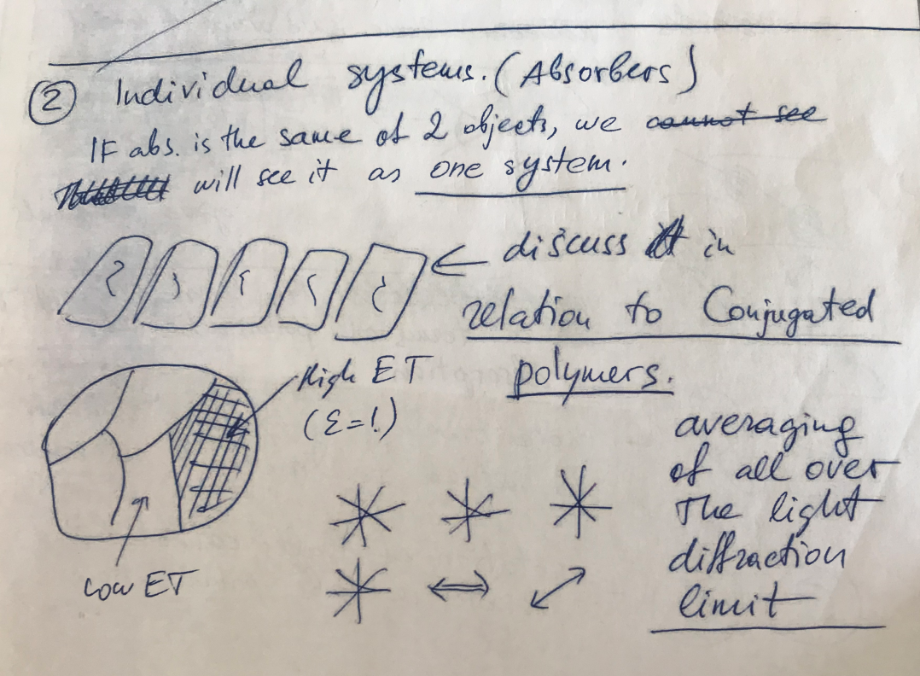
Multiple systems (ms) possessing their own emitter and 𝜀
-- Conjugated polymer (bulk material)
0.8
0.2
0.2
0°
36°
72°
P1
P2
P3
et_1 = 0
et_2 = 0.2
et_3 = 1
Pms = P1 + P2 + P3
SFA3 fitting results
 | P1 | P2 | P3 | Pms
M_funnel | 0.00 | 0.98 | 0.88 | 0.77
phase_funnel (degree) | - | 0 | 42 | 36
𝜀 | 0.00 | 0.20 | 1.00 | 0.40
SFA3 works well for all the above systems.
The funnel is linealy combination of individual system.
𝜀_ms = (𝜀1 + 𝜀2 + 𝜀3)/3.

Slide 8
The numbers of the absorbers are the same for all systems. The absorbers are oriented in P1 (0 – 180 degree), P2 (0 – 60 degree), P3 (20 – 60 degree).
The numbers of the absorbers are the same for all systems. The absorbers are oriented in P1 (0 – 180 degree), P2 (0 – 60 degree), P3 (20 – 60 degree).
1.0
1.0
1.0
1.0
0.2
0.6
36°
36°
36°
36°
36°
36°
P1
P2
P3
P1
P2
P3
et_1 = 1.0
et_2 = 0.2
et_3 = 0.6
et_1 = 1.0
et_2 = 0.2
et_3 = 0.6
Pms = P1 + P2 + P3
Pms = P1 + P2 + P3
SFA3 fitting results
 | P1 | P2 | P3 | Pms
M_funnel | 0.99 | 0.99 | 0.99 | 0.99
phase_funnel (degree) | 36.00 | 36.00 | 36.00 | 36.00
𝜀 | 1.00 | 1.00 | 1.00 | 0.99
residue | 0.00 | 0.00 | 0.00 | 0.001
SFA3 fitting results
 | P1 | P2 | P3 | Pms
M_funnel | 0.99 | 0.99 | 0.99 | 0.99
phase_funnel (degree) | 36.00 | 35.99 | 35.99 | 35.1
𝜀 | 1.00 | 0.20 | 0.60 | 0.84
residue | 0.00 | 0.00 | 0.00 | 0.002
The residue is slightly higher, but SFA model still works well.
If 𝜀1 = 𝜀2 = 𝜀3 = 1 then 𝜀_ms = 1 as well.
𝜀_ms = (𝜀1 + 𝜀2 + 𝜀3)/3
The property of funnel is independent on the anisotropy of sample (dipole orientation)
One system
The residue is slightly higher, but SFA model still works well.
𝜀_ms [0.84] ＞ (𝜀1 + 𝜀2 + 𝜀3)/3 [0.6], Why???
The property of funnel is independent on the anisotropy of sample (dipole orientation)

Slide 9
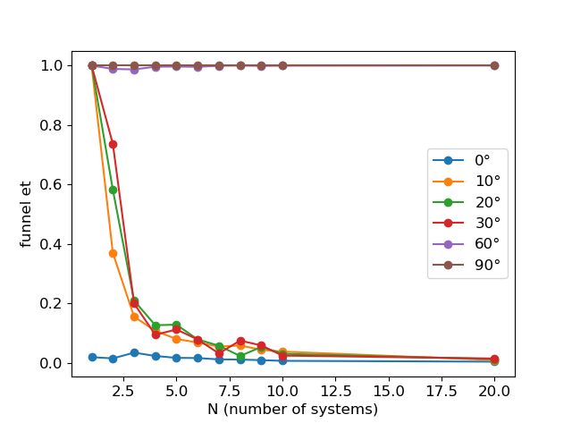
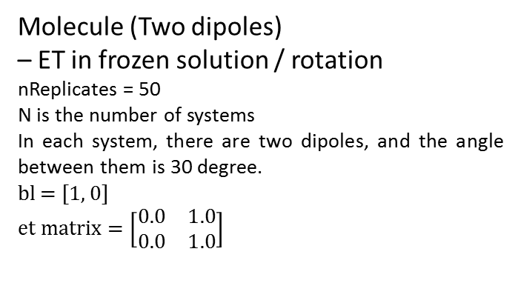
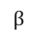
Molecule (Two dipoles)
– ET in frozen solution / rotation
nReplicates = 50
N is the number of systems
In each system, there are two dipoles, and the angle between them is 30 degree.
bl = [1, 0]
$$et matrix=\left[\begin{matrix}0.0 & 1.0 \\ 0.0 & 1.0\end{matrix}\right]$$
100%
N = 1
$$β$$
N = 2
A molecule have independent polarized absorber (M = 1) and emitter (M = 1). 100% energy transfer from absorber to emitter.
N = 4

Slide 10
If systems possess the same absorbers but different emitters, 𝜀_ms = (𝜀_1 + 𝜀_2 + 𝜀_3 ... 𝜀_n) / n.
If systems possess the same emitters but different absorbers, 𝜀_ms > (𝜀_1 + 𝜀_2 + 𝜀_3 ... 𝜀_n) / n.
If systems possess different absorbers and emitters, the model does not work well when the number of systems (N) is small. And 𝜀_ms will be decreased by increasing N.

Slide 11
Small system (4 dipoles, no et)
The fitting results are dependent on the orientation (distribution) of the dipoles. The model works better when the dipoles are homogeneously distributed, such as [0, 30, 60, 90], but it does not work well when dipoles oriented at [0, 60, 70, 90]. (More distributions have been tested)

Slide 12
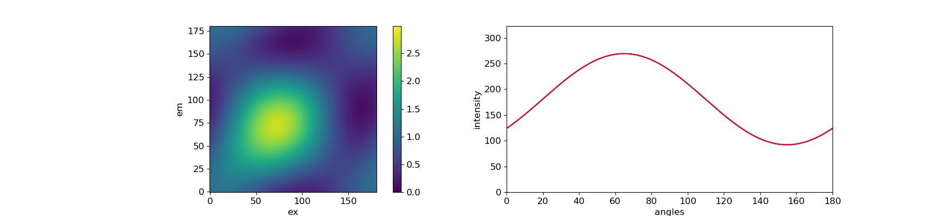
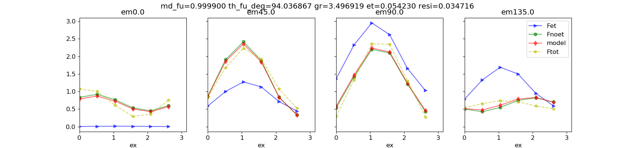
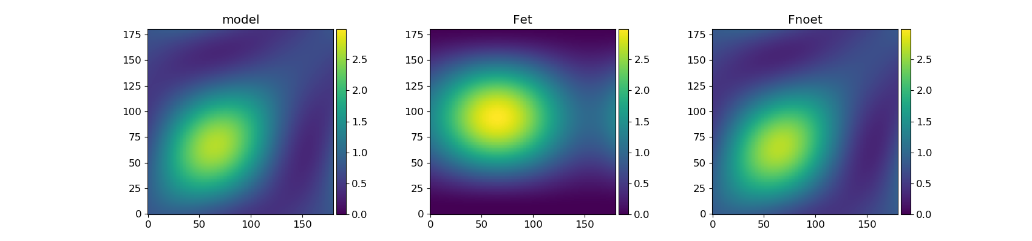
[0, 60, 70, 90]

Slide 13
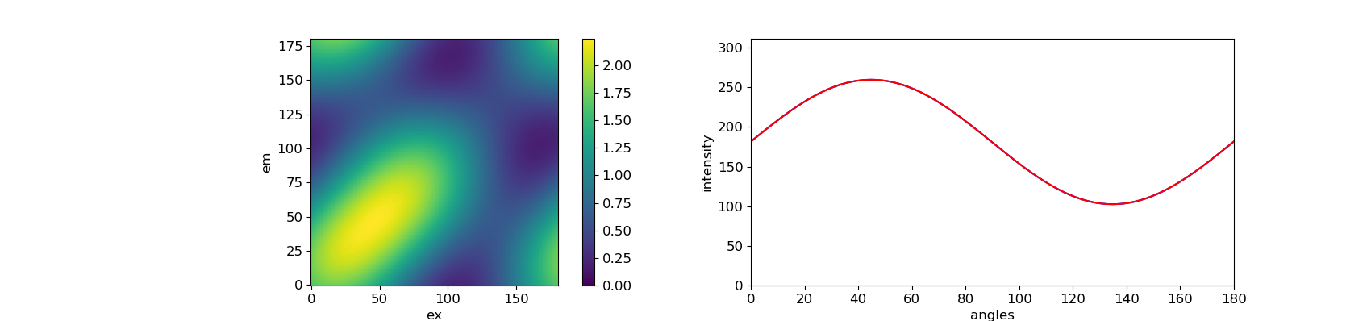
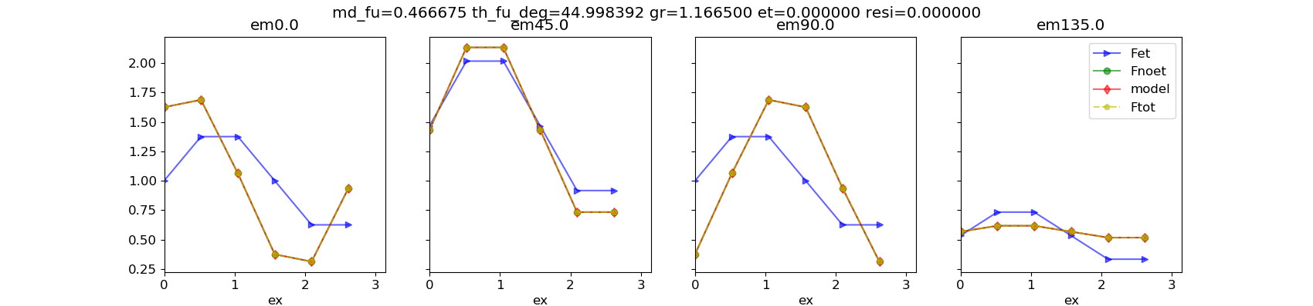
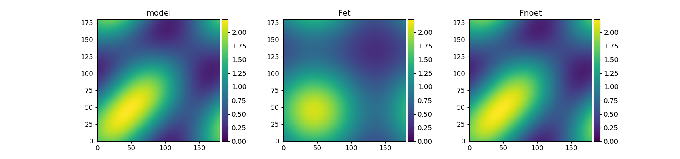
[0, 30, 60, 90]

Slide 14
Extract more info from Model, Fet, Fnoet
1. Curve on diagonal
2. Curve of anisotropy r0 – ex angles

Slide 15
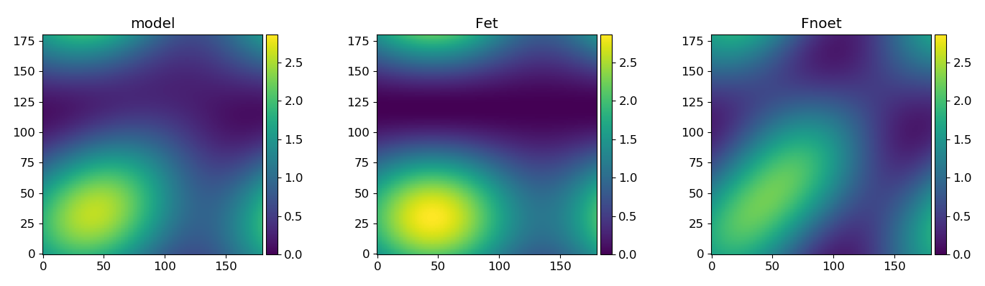
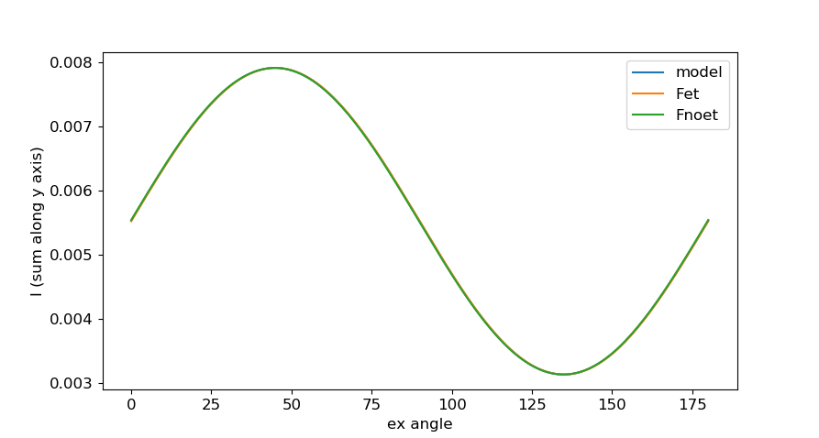
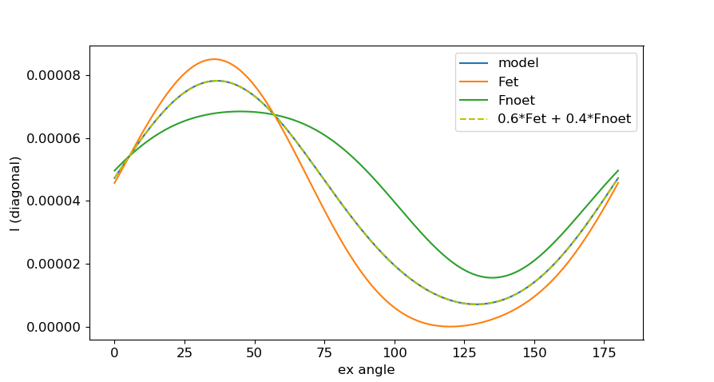
Mex from Model, Fnoet and Fet portrait.
dipole orientation
[0, 30, 60, 90]
et matrix
[0.4, 0.6, 0.0, 0.0]
[0.0, 1.0, 0.0, 0.0]
[0.0, 0.6, 0.4, 0.0]
[0.0, 0.6, 0.0, 0.4]
fitting results
M_funnel = 0.99
Phase_funnel = 30°
gr = 1.17
et = 0.60
resi = 0.00
1
𝜺
1 - 𝜺
1. Model, Fet and Fnoet have the same Mex giving the info about orientation of dipoles (photoselection). Mex and phase_ex are used for three dipole model to calculate gr.
Do they (model, Fet, Fnoet) have to have the same Mex? Can Fet portrait have a different Mex? Can this improve the usability of SFA3 model?
Then if Fet_Mex = Fnoet_Mex, it means multi-systems have the same absorption, or we can say there are only one system. If Fet_Mex ≠ Fnoet_Mex, it means there are many systems possessing different Mex.
2. How to undestand the curve on diagonal? They are not cos. Can this be an useful information?

Slide 16
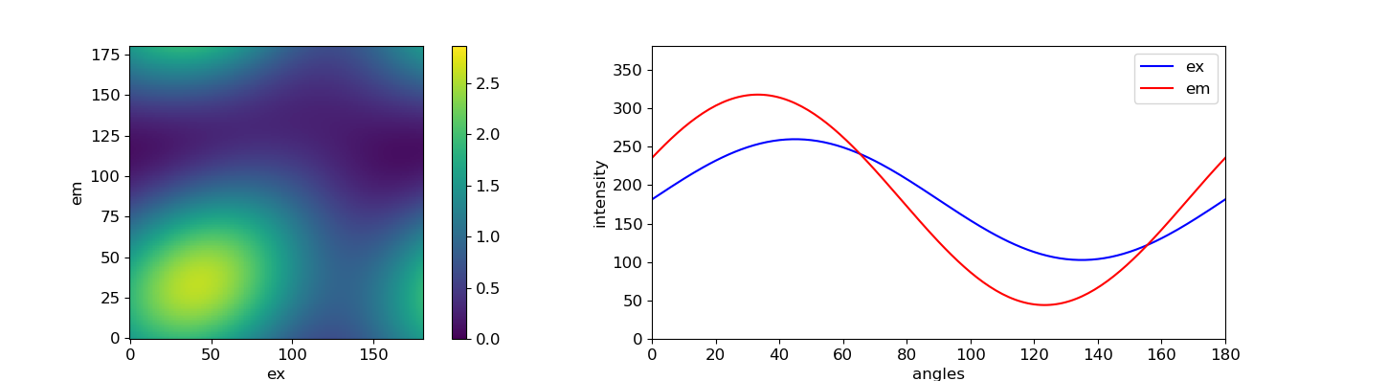
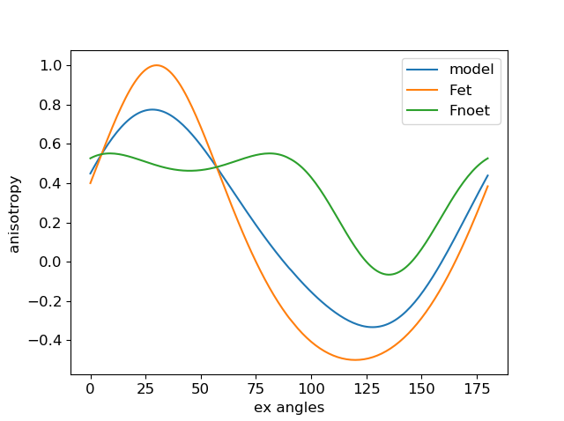
The anisotropic sample [0,30,60,90] has maximum absorption at 45 degree. But it has the highest anisotropy at 30 degree.

Slide 18
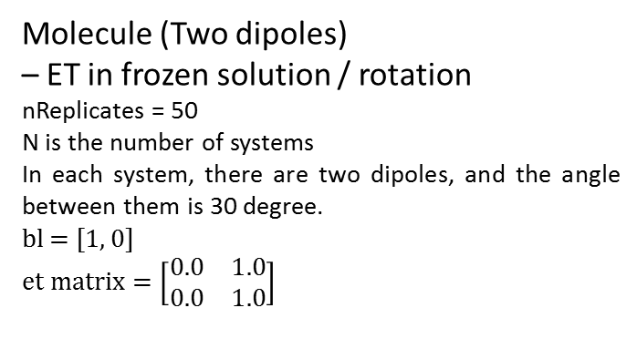
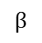
Molecule (Two dipoles)
– ET in frozen solution / rotation
nReplicates = 50
N is the number of systems
In each system, there are two dipoles, and the angle between them is 30 degree.
bl = [1, 0]
$$et matrix=\left[\begin{matrix}0.0 & 1.0 \\ 0.0 & 1.0\end{matrix}\right]$$
100%
N = 1
$$β$$
N = 2
A molecule have independent polarized absorber (M = 1) and emitter (M = 1). 100% energy transfer from absorber to emitter.
N = 4

Slide 19
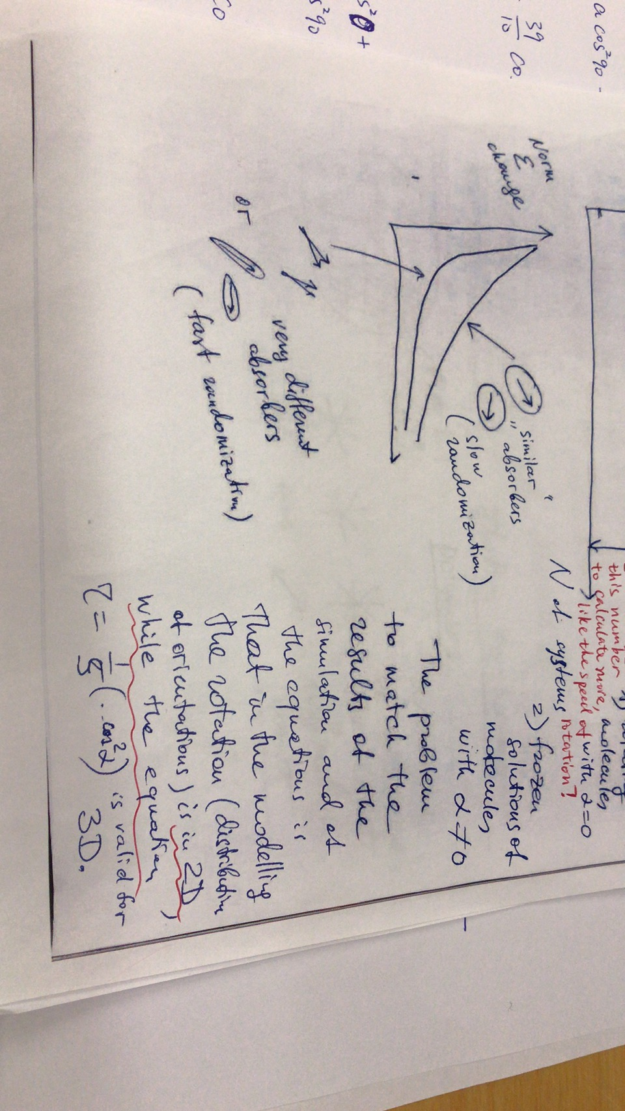
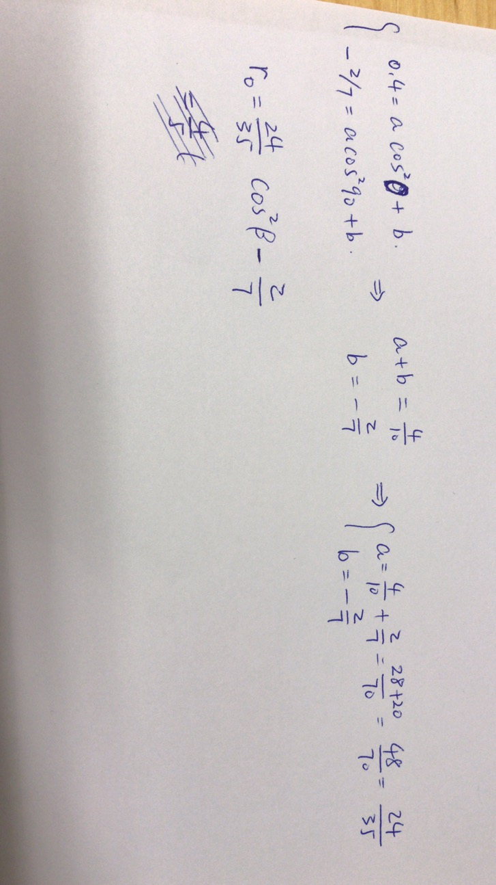

Slide 20
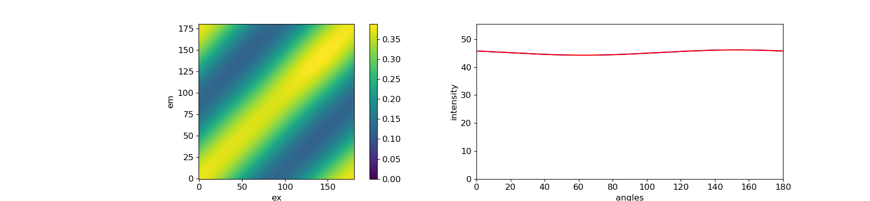
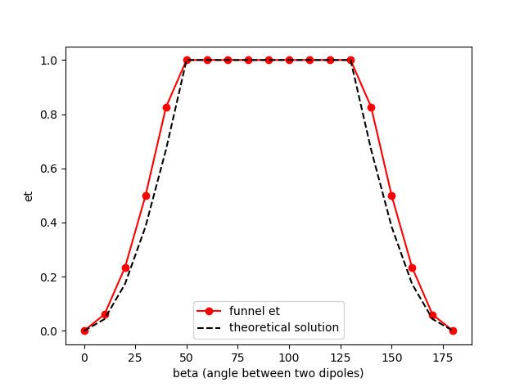
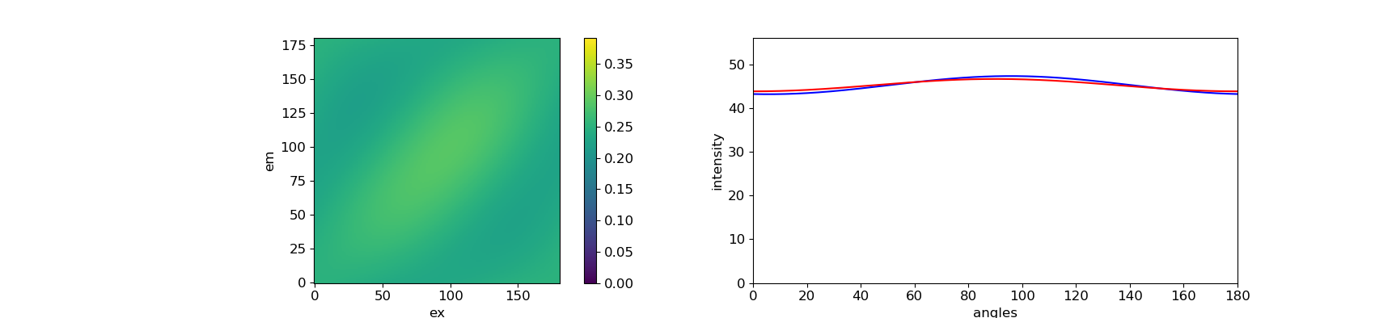
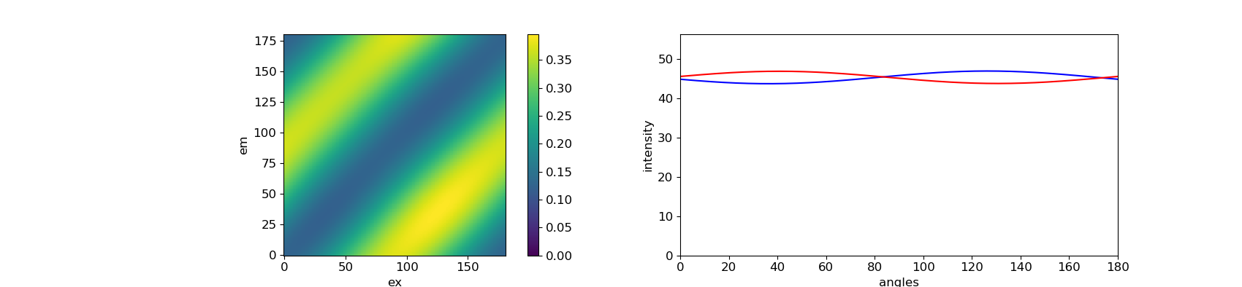
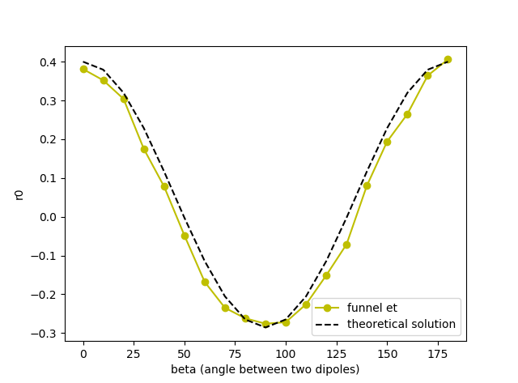
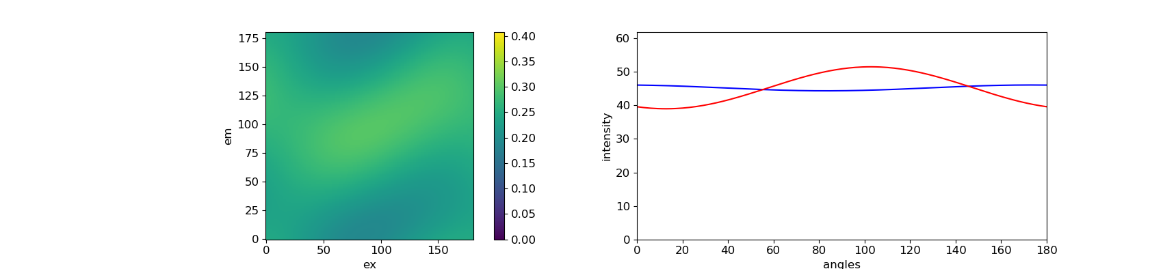
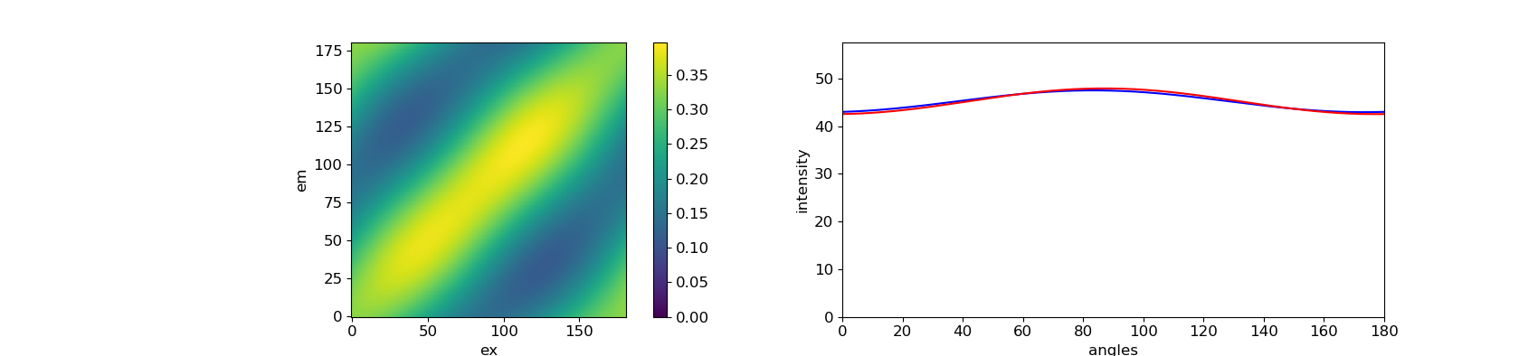
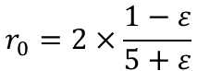
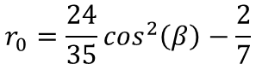
0°
40°
Work for 2D
$$r_{0}=\frac{24}{35}\cos^{2}\left(β\right)−\frac{2}{7}$$
90°
$$r_{0}=2×\frac{1−ε}{5+ε}$$
140°
170°

Slide 24
Note for myself

Slide 25
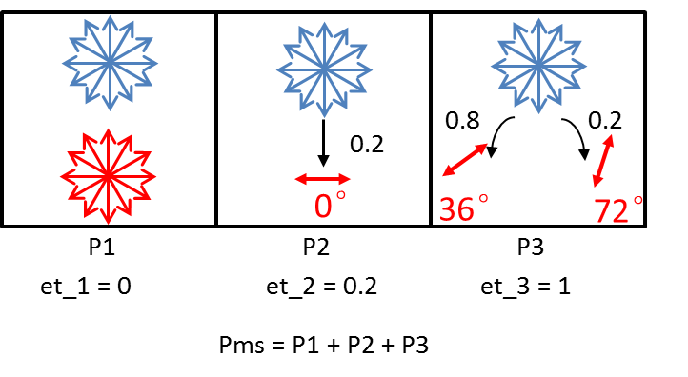
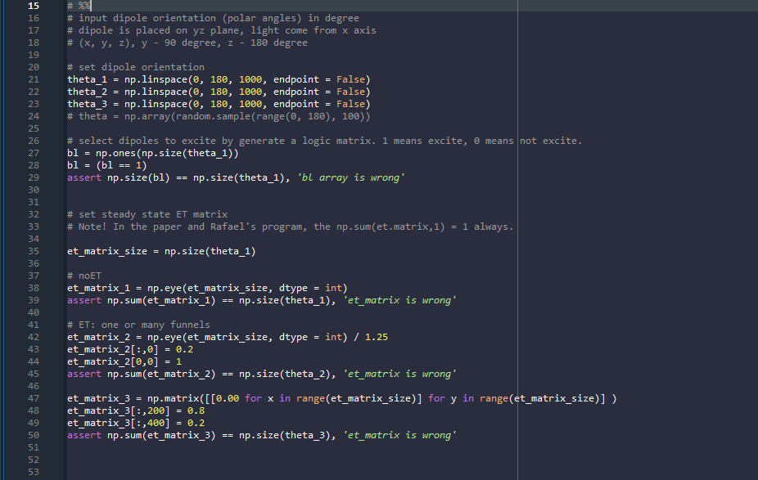

Slide 26
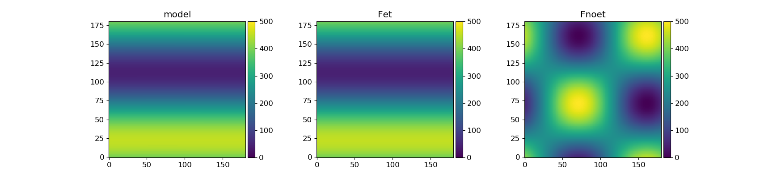
How is the intitial value influence fitting results.
Especially when Mex = 0, different initial value of phase_ex will lead to different fitting results.
Find out how the fitting function so.fmin_l_bfgs_b in python works.
emitter1
emitter2
Initial value
Mex = 0
Phase_ex = 0
Initial value
Mex = 0
Phase_ex = 22 / 36 / 45 / 90 degree
The Fnoet portrait does not show the right anisotropy of the system.

